Slide 1




Penetration
Testing

Slide 2

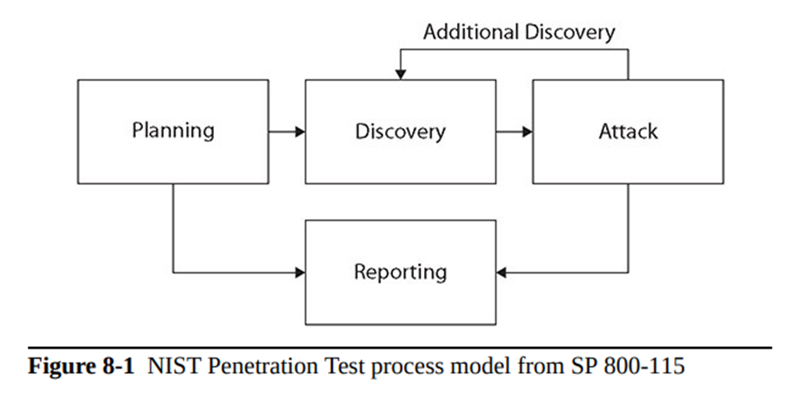
Penetration
Testing
Penetration testing simulates an attack from a malicious outsider—probing your network and systems for a way in (often any way in). Penetration tests, or pen tests for short, are often the most aggressive form of security testing and can take on many forms, depending on what is considered “in” or “out” of scope.

Slide 3

Penetration
Testing
Known environment (white box) testing, sometimes called clear box testing, test the internal structures and processing within an application for bugs, vulnerabilities, and so on

Slide 4
Penetration
Testing
Unknown environment (black box) testing is a software-testing technique that consists of finding implementation bugs using malformed/semi-malformed data injection in an automated fashion. Unknown environment techniques test the functionality of the software, usually from an external or user perspective.

Slide 5
Penetration
Testing
In a partially known environment test, the testers typically have some knowledge of the software, network, or systems they are testing.

Slide 6
Penetration
Testing
The rules of engagement associated with a penetration test are critical for several reasons. The activities associated with a penetration test are illegal if not authorized, and the rules of engagement specify the legal authority that the penetration testers have in performing their duties.

Slide 7
Penetration
Testing
Lateral movement, sometimes referred to as network lateral movement, refers to the process used by attackers to move deeper into a network to get to the target data. In most cases, the initial entry into a system is via a user account that does not have access to the desired material, nor does the account have the appropriate levels of permissions.

Slide 8
Penetration
Testing
Privilege escalation is the process of gaining increased privileges for an account. This can be done in a variety of ways—sometimes legitimate, sometimes via a bug or vulnerability.

Slide 9
Penetration
Testing
Persistence is the ability to exist beyond a machine reboot or after disconnection. The term advanced persistent threat (APT) refers to a methodology that is focused first and foremost about maintaining persistence.

Slide 10
Penetration
Testing
Cleanup, or covering one’s tracks, is an essential step in a professional’s toolkit. Clearing logs, blocking remote logging, messing with system history, and using reverse shells and Internet Control Message Protocol (ICMP) tunnels to avoid detection and logging are some of the methods employed.

Slide 11
Penetration
Testing
Bug bounty programs are mechanisms where companies pay hackers for revealing the details of vulnerabilities that they discover, providing the companies an opportunity to correct the issues. Most bug bounties pay some form of cash reward, with several major companies like Microsoft, Apple, and Google paying up to six-digit rewards for very critical vulnerabilities.

Slide 12
Penetration
Testing
Pivoting is a technique similar to lateral movement. In pivoting, one moves to a new location in a network and begins the attack process over again, performing scans to see machines that were not visible from the outside.

Slide 13
Passive and
Active Reconnaissance
Passive reconnaissance is performed using methods to gain information about targeted computers and networks without actively engaging with the target systems and thus avoiding detection.
In active reconnaissance, the attacker engages with the target system, typically conducting a port scan to find any open ports.

Slide 14
Passive and
Active Reconnaissance
Using a drone to fly over a facility and capture wireless network traffic is called war flying.

Slide 15
Passive and
Active Reconnaissance
War driving is the same concept as war flying, but rather than using a drone to capture the traffic, one simply drives past the points of access.

Slide 16
Passive and
Active Reconnaissance
Footprinting, also called reconnaissance, is the first step in gaining active information on a network. Using footprinting, a pen tester can gather information about computer systems and the entities they belong to, and in some cases user information as well.

Slide 17
Passive and
Active Reconnaissance
OSINT (open source intelligence) is the technique of using publicly available information sources to gather information on a system. OSINT is not a single method but rather an entire set of both qualitative and quantitative methods that can be used to collect useful information.

Slide 18
Thank
You

